Slide 1
Formal Methods 2021/22
Instructor: Prof. Giuseppe De Giacomo

Slide 2
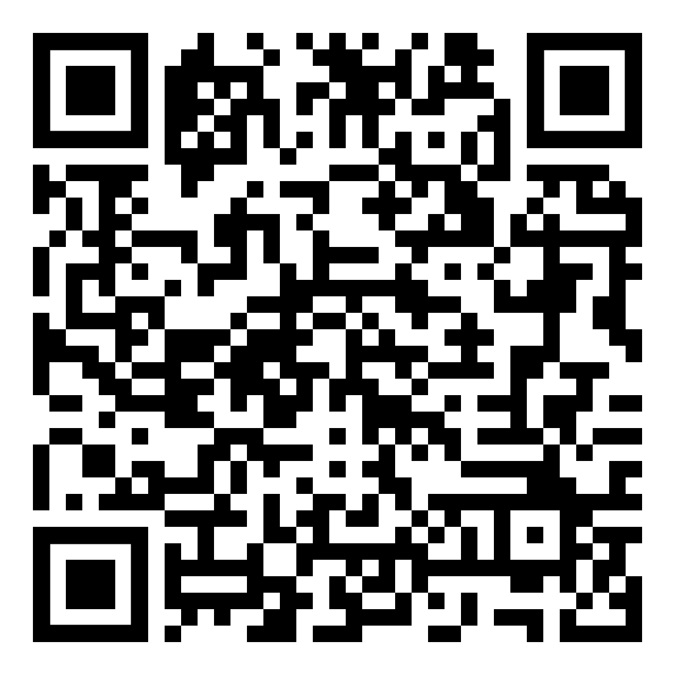
Website
https://sites.google.com/diag.uniroma1.it/formalmethods202122-degiacomo Very active! It includes:
Course Material: slides, notes, references, etc.
Video of the lectures
Lecture log
Forum
Other stuff

Slide 3
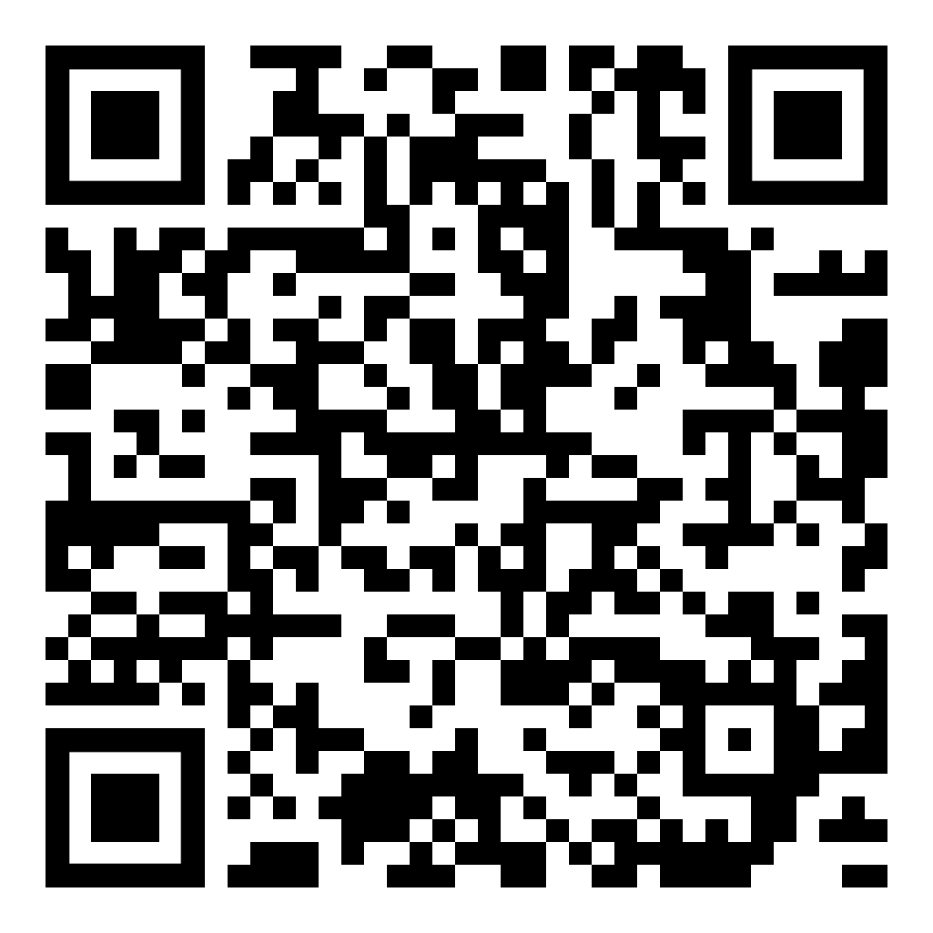
Forum
The course has a forum for students and teacher to exchange information, problems, solution, etc.
https://groups.google.com/a/diag.uniroma1.it/g/formal-methods-20212022
Register to the course forum now!!!

Slide 4
Lecture Log
First order logic evaluation and logical implication
Containment of conjunctive queries
Incomplete information
UML class Diagrams as logical theories
Query Answering through UML Diagrams
Semantics of programs (abstract operational semantics)
Hoare Logic
Fixpoint theory
Transition Systems
Bisimulation
mu-Calculus, CTL and LTL
Model Checking
All lectures on the lecture log on the course web site
DATA
PROCESSES

